Slide 1
welcome
to
karnataka

Slide 2
Top 5 places in Karnataka
Murdeshwar
Apsarakonda
Eco beach
Karwar
Ankola

Slide 3
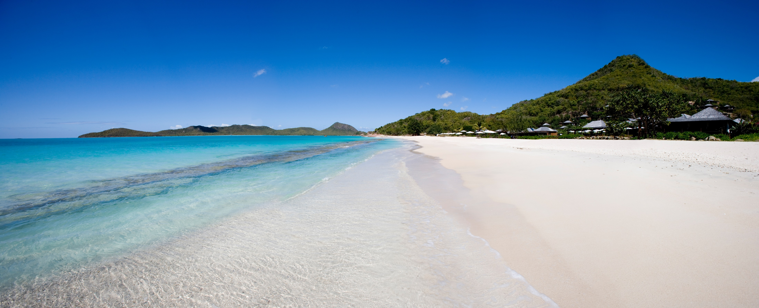
1.murdeshwara
Murdeshwara is a town in utttara kannada diststrict in state of Karnataka , india . It’s famous for worlds second tallest shiva statue , the town lies on the coast of the arabian sea and famous for murdeshwara temple . The town has railway station on the Manglore –Mumbai konkan railway route
This Photo by Unknown Author is licensed under CC BY-SA

Slide 4
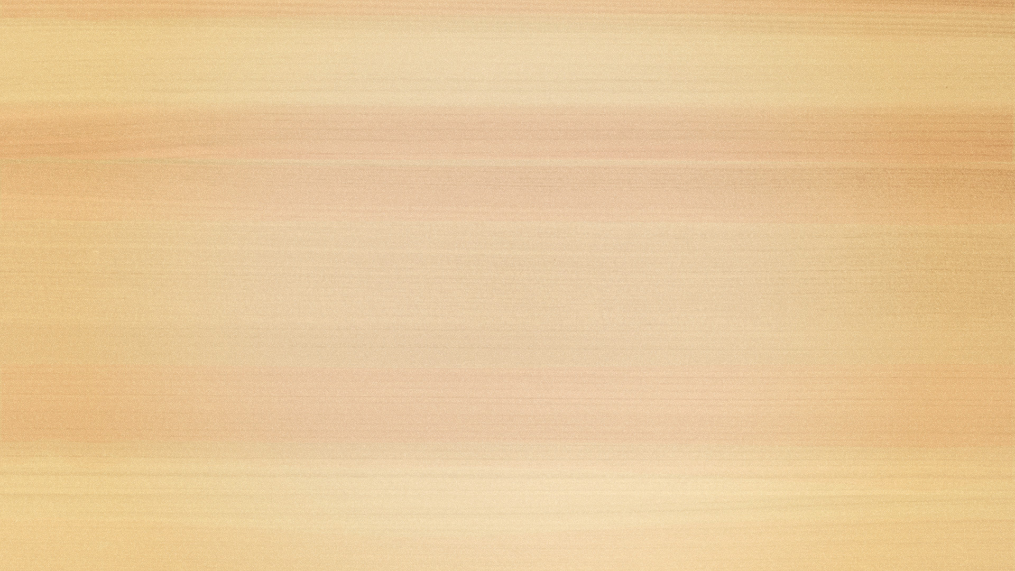

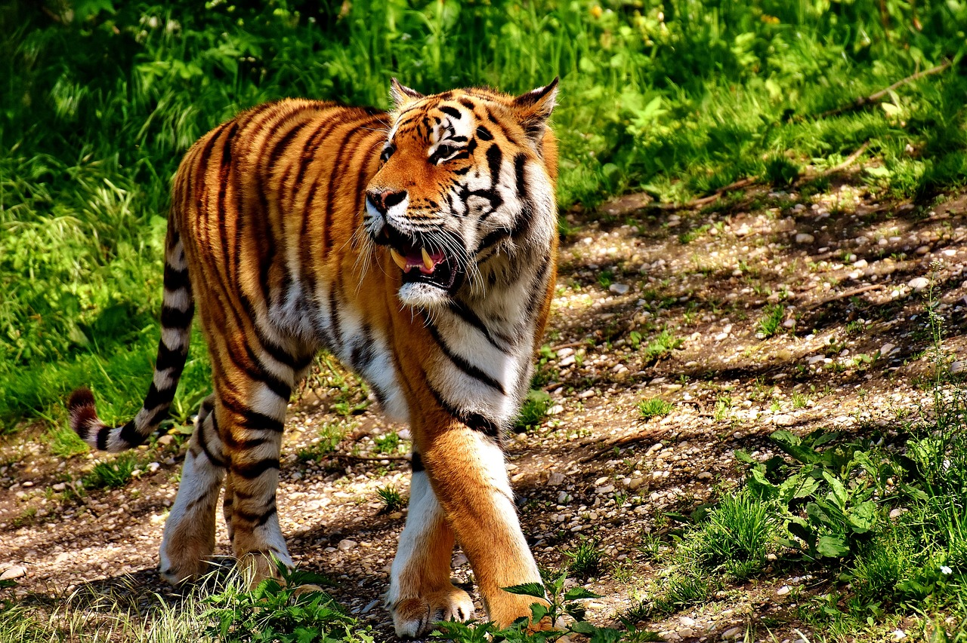
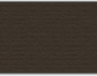
Apserkoda
Apserkonda is an emerging tourist village near Honnavar, in the district of Uttara Kannada, Karnataka, India. It is situated 8 km from the Honnavar bus stand.^{[1]}
Etymology[edit]
Apsarkonda means Pond of Angels. This is named after a pond facing the beach. The legend associated with the name of the waterfall is that it was the chosen place of the angels to take a bath and relax.^{[2]}

Slide 5
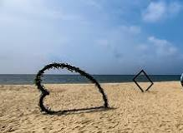
Eco beach
Where is Eco Beach located?
Just 20 km away from the famous Murudeshwara Temple, Eco Beach is one of the “Blue Flag' certified beaches in India. Earlier known as Kasargod Beach, Eco beach is one of the most virgin, pristine and serene beaches in the whole coastal belt.08-Feb-2023

Slide 6
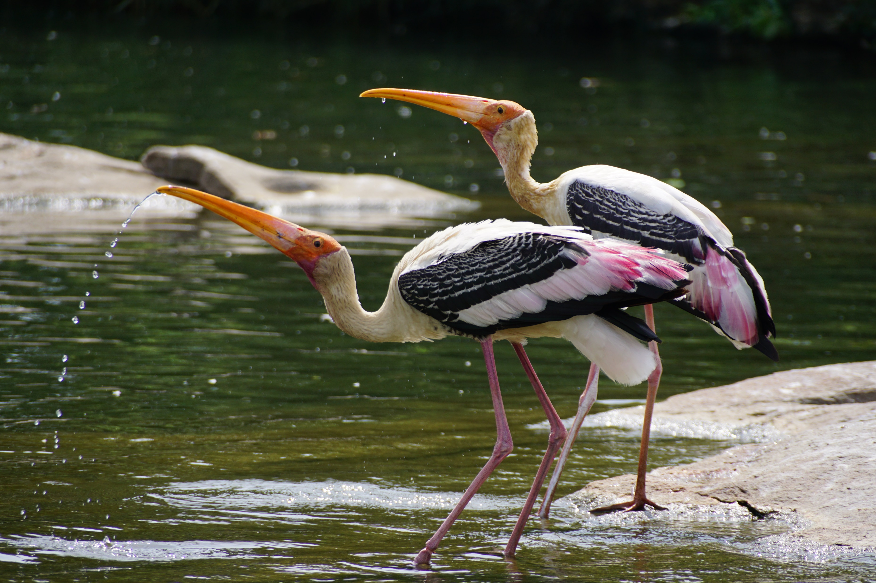
Karwar

Slide 7
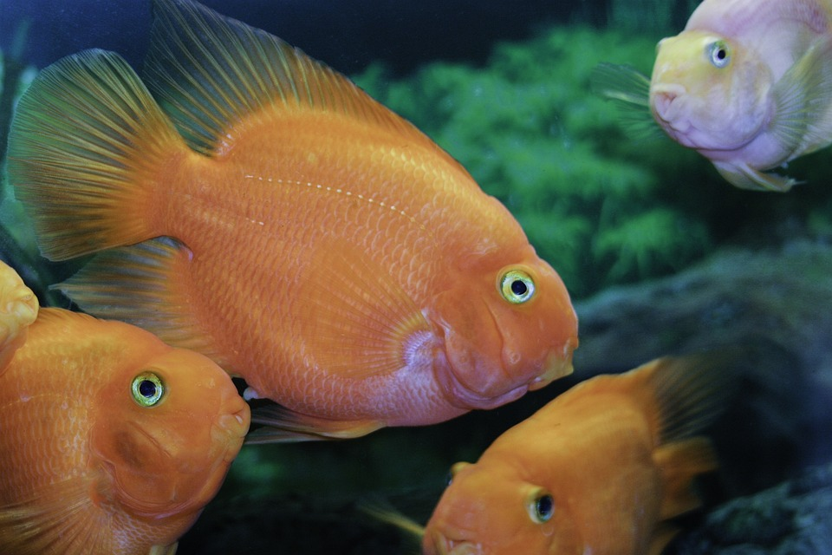
Ankola
Karnataka (/kərˈnɑːtəkə/; ISO: Karnāṭaka, Kannada: [kɐɾˈnaːʈɐkɐ], also known as Karunāḍu), formerly Mysore State /maɪˈsɔːr/, is a state in the southwestern region of India. It was formed as Mysore State on 1 November 1956, with the passage of the States Reorganisation Act, and renamed Karnataka in 1973. The state was part of the Carnatic region in British terminology. Its capital and largest city is Bengaluru (Bangalore).
Karnataka is bordered by the Lakshadweep Sea to the west, Goa to the northwest, Maharashtra to the north, Telangana to the northeast, Andhra Pradesh to the east, Tamil Nadu to the southeast, and Kerala to the southwest. It is the only southern state to have land borders with all of the other four southern Indian sister states. The state covers an area of 191,791 km² (74,051 sq mi), or 5.83 percent of the total geographical area of India.^{[12]} It is the sixth-largest Indian state by area.^{[12]} With 61,130,704 inhabitants at the 2011 census, Karnataka is the eighth-largest state by population, comprising 31 districts. Kannada, one of the classical languages of India, is the most widely spoken and official language of the state. Other minority languages spoken include Urdu, Konkani, Marathi, Tulu, Tamil, Telugu, Malayalam, Kodava and Beary. Karnataka also contains some of the only villages in India where Sanskrit is primarily spoken.^{[13][14][15]}

